Slide 1
4 P’s in PM Spectrum (2)
Lecture 4

Slide 2
4 P’s in PM Spectrum
People
Product
Process
Project

Slide 3

The Process [1]
Process
Framework Activities
Process Models
Process Decomposition

Slide 4
The Process
A software process provides the framework from which a comprehensive plan for software development can be established
Common process framework activities which are applicable to all software projects are:
  Communication
  Planning
  Modeling
  Construction
  Deployment

Slide 5

Framework Activities
These characterize a software process and are applicable to
all software projects
  Communication
  Planning
  Modeling
  Construction
  Deployment
These are applied to software engineering work tasks (e.g.,
different product functions).

Slide 6
Process Models
Different process models:
  Linear sequential, Prototyping, RAD, Spiral, Formal …
model
to use
Project manager must decide about depending on
Customers who have requested the product
People who would work on the project
Product characteristics
Project environment
Project planning begins once model is selected

Slide 7
Process Decomposition
The way a process is decomposed
depends
on project
Complexity.
Decomposition involves outlining each process of framework activity.
work tasks involved in
Example of decomposition for "communication" activity for a simple project:
  Develop a list of clarification issues
  Meet with customer to discuss clarification issues
  Jointly develop statement of scope
  Review the statement of scope with all concerned
  Modify the statement of scope if required

Slide 8

The Project [1]
Project
Signs of Projects Risk
How to Avoid Project Risks

Slide 9

The Projects
The software projects must
be planned
and controlled
effectively to avoid complexities.
The project managers and engineers must understand the critical success factors and develop a common sense approach for planning, monitoring and controlling the project.

Slide 10
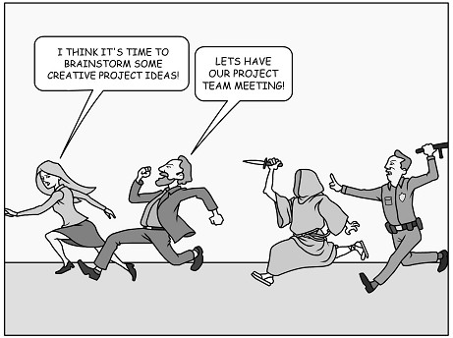
Signs of Projects Risk
John Reel describes ten signs that indicate that project is in
danger:
  Software people don’t understand customer needs
  Product scope is poorly defined
  Changes are managed poorly
  The chosen technology changes
  Business needs change
  Deadlines are unrealistic
  Users are resistant
  Sponsorship is lost
  Team lacks skills
  Managers avoid best practices

Slide 11



How to avoid problems?
Start on the right foot
  Involves detailed understanding of project
  Setting realistic objectives & expectations
  Selecting the right team
  Facilitating the team
Maintain Momentum
  Provide incentives
  Reduce bureaucracy and give autonomy to team members but with supervision
Track Progress
Assess progress
as work
products are produced

Slide 12



How to avoid problems?
Make smart decisions
  When possible, use existing software components / Commercial off-the-shelf (COTS) software
  Choose standard approaches and keep
it simple
  Avoid risks and allocate more time than needed for complex/risky tasks
Conduct a postmortem analysis
  Compare planned and actual schedule
  Collect and analyze project metrics (standards)
  Get feedback from team and customers
  Establish record of lessons learnt for each project

Slide 13

W⁵HH Principle

Slide 14
W⁵HH principle
Suggested by Barry Boehm in one of his papers
Excellent planning outline for project managers and software team
Applicable to all sizes of software projects
It is an approach to address
  Project objectives
  Milestones & schedule
  Responsibilities
  Management & technical approaches
  Required resources

Slide 15
W⁵HH principle
Why is the system being developed?
  Answer to this question help assess validity of business reason for the software work.
  It answers if the business purpose justifies the expenditure of people, time and money.
What will be done?
  Answer to this question establishes the task set required for project.
When will it be done?
  Answer to this question helps the team establish a project schedule by identifying when tasks have to be conducted and when milestones are to be reached.

Slide 16
W⁵HH principle
Who is responsible for a function?
  Answer to this question establishes roles and responsibility of each team member.
Where are they organizationally located?
  Answer to this question indicates that all roles and responsibilities are not limited to the software team itself, the customers, users and stakeholders also have responsibilities.
How will the job be carried out technically and managerially?
  Once product scope establishes, a technical and management strategy must be defined for it.
How much of each resource is needed?
  Answer to this question is derived by developing estimates based on answers to
earlier questions.

Slide 17
References
1.
Software Engineering by Roger Pressman
Team Structures Portion taken from Gary Pollice lectures on Software Project Management http://recruitment.naukrihub.com/recruitment-vs-selection.html
http://en.wikipedia.org/wiki/Performance_management http://en.wikipedia.org/wiki/Workers%27_compensation http://www.inovus.com/organiza.htm http://www.wisegeek.com/what-is-career-development.htm
http://pathikconsulting.com/team-and-culture-development-corporate-culture-consulting.html http://www.conx2u.com/index.php?option=com_content&view=article&id=53&Itemid=55
http://en.wikipedia.org/wiki/Bulletin_board_system
2.
3.
4.
5.
6.
7.
8.
9.
10.

Slide 18


